Slide 1
2016 New Coder Survey data Analysis
Group Member: Chuyao Xiong

Slide 2
Goals of the project
Make some basic exploratory analysis based on the data set, including age, gender, income, city population, country of citizen, etc.
Predict the income given the age, gender, school degree, hours spent learning, and months spent on programming.

Slide 3
Methodology
Exploratory Analysis: Statistical work using MapReduce and Spark.
Machine Learning Model: Multiple Linear Regression
Visualization: Zeppelin

Slide 4
Data sources
The data came from survey result of more than 15,000 people who are actively learning to code.
The data sources is a single csv format file, which covers participants’ individual responses to 48 questions, including their basic information, related experience and how did they learn coding.
Link: https://www.kaggle.com/freecodecamp/2016-new-coder-survey-

Slide 5
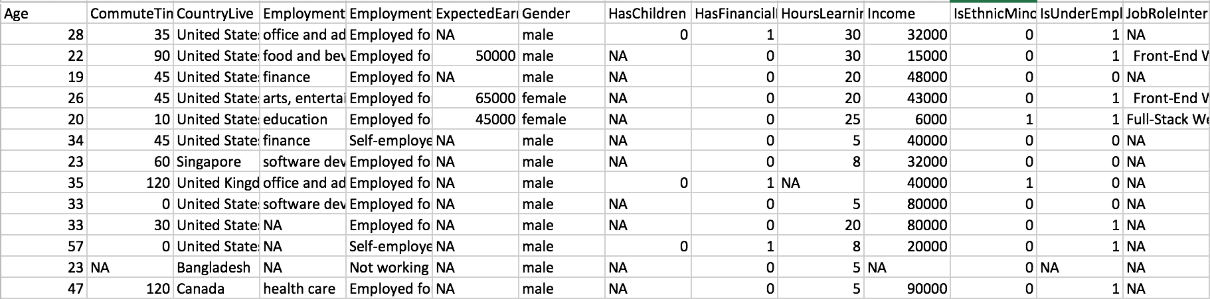
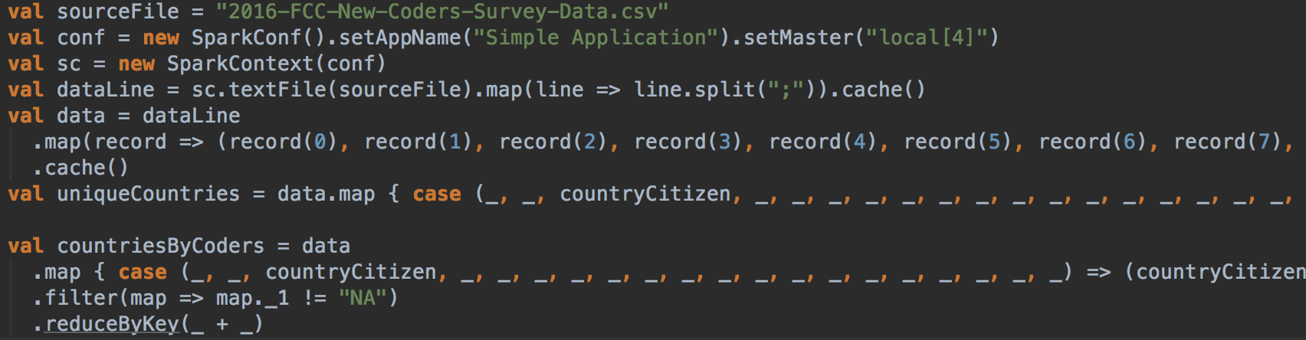
Exploratory Analysis
Number of total records.
Top ten unique countries where the participants live.
Age distribution.
Gender radio.
Income distribution.
Average income greater than 50000 in terms of country / age.

Slide 6
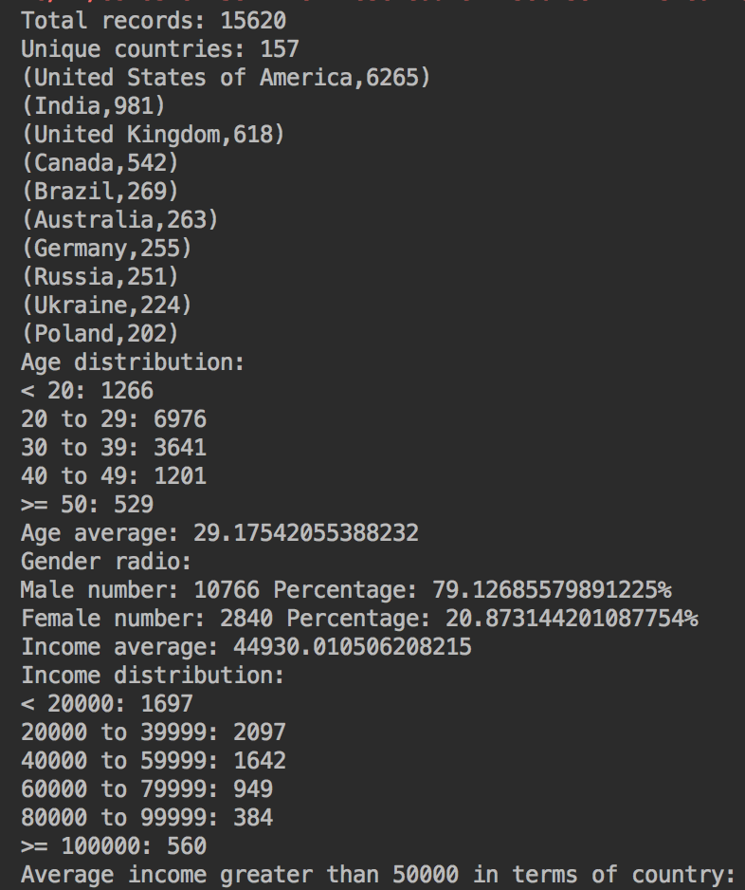
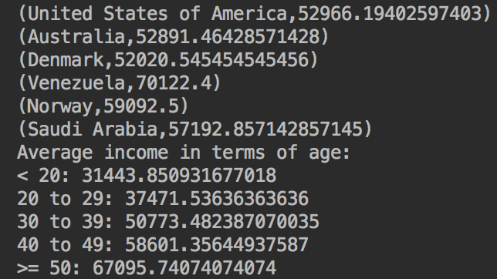
result

Slide 7
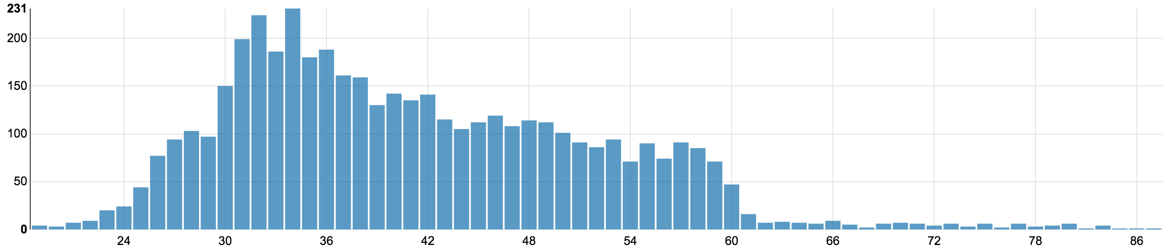
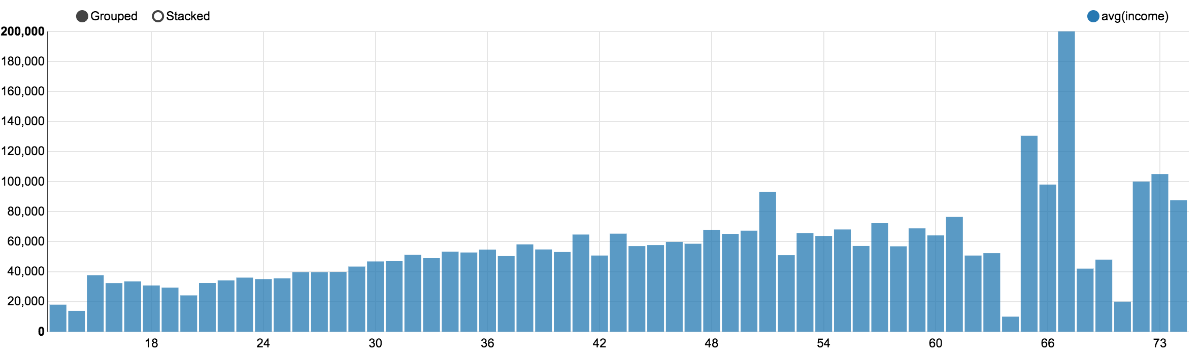
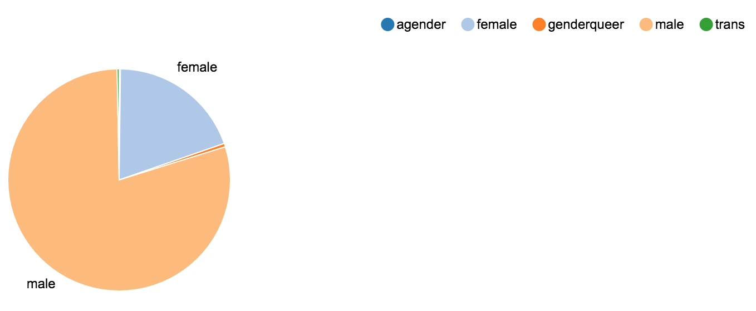
Age distribution
Average income
in terms of age
Gender radio

Slide 8
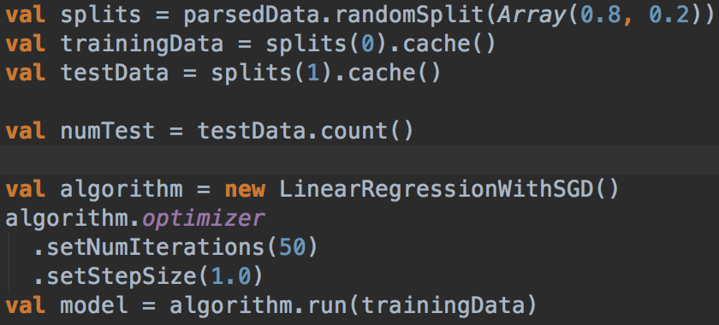
Train algorithm
We have a list of records and we want to predict the income. The income is our label. Each record is identified by age, gender, school degree, hours spent learning, and months spent on programming. These are the features of a record.
A very trivial normalization was applied by turning rating String into Double and by transforming age and other features to Double values between 0 and 1. For example Record("A", 600, 50) may become vector [0.7, 0.4, 0.8] (depending on maxHours and maxAge).
LinearRegressionWithSGD: Use Spark’s linear regression algorithm to train the model.
Split data into training (80%) and test (20%)

Slide 9
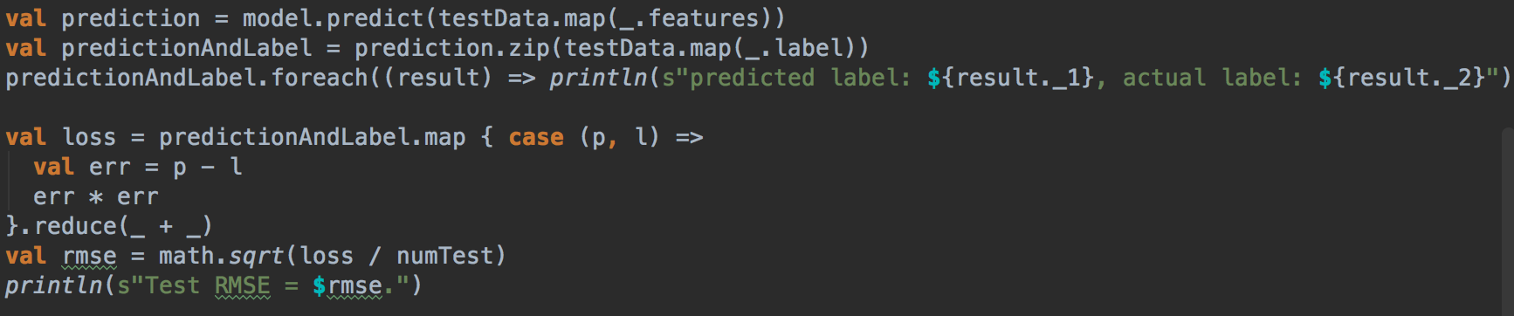
Predict & Evaluate
Evaluate model on training examples and compute training error
Created the testing data with labels, compare the predicted labels and actual labels
Calculate root mean squared error(RMSE), which compares a square root of sum of squared differences between predicted and actual label divided by number of comparisons

Slide 10
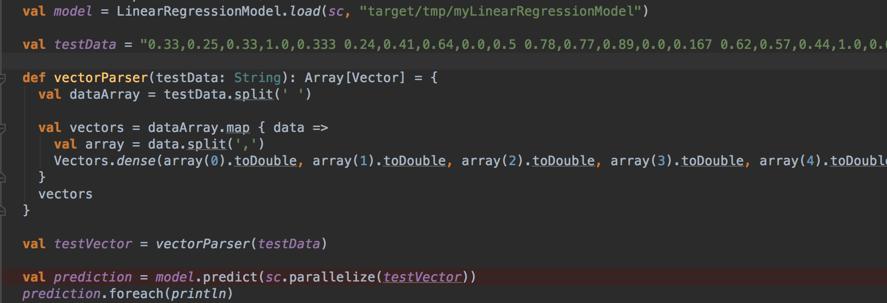
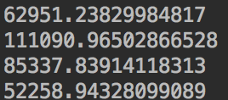
Predict & Evaluate
Load the model and make some prediction
Result:

Slide 11
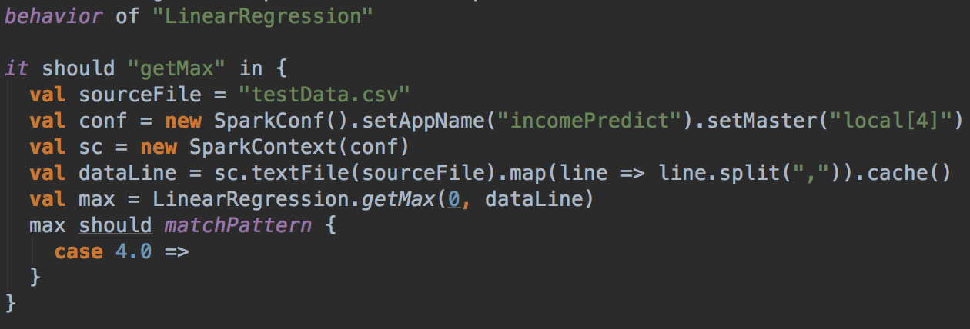
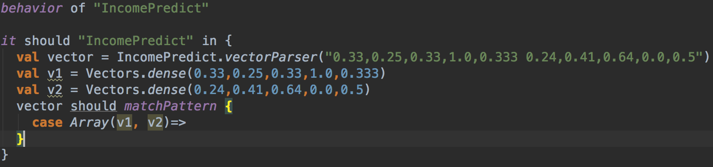
Test cases

Slide 12
Tools
Apache Spark
Implement machine learning model(MLlib)
Zeppelin
IntelliJ IDEA

Slide 13
Acceptance criteria
Accomplish statistical work by drawing graphs of part of the columns in the table(age, gender, income, city population, country of citizen).(Result: Completed)
Successfully predict the income given related information in about 0.2 calculate root mean squared error(RMSE), , show the results to customer. (Result: RMSE = 0.17)

Slide 14
Thank you!

